Slide 1


ORB-SLAM
Janu 20, 2023
CONTACT
Electrical Engineering
1st Engineering Building Room 201
Tel. +82 52 217 3542 Web. http://eche.unist.ac.krAddress

Slide 2

ORB-SLAM
(A versatile and Accurate Monocular SLAM System)
ORB - Oriented FAST & Rotated Brief
FAST : Features from Accelerated Segment Test
BRIEF : Binary Robust Independent Elementary Features
SLAM - Simultaneous Localizing & Mapping
Localizing : Estimation of Camera Pose
Mapping : 3D Map Reconstruction
Notes:
단안 카메라 => 하나의 카메라 사용

Slide 3
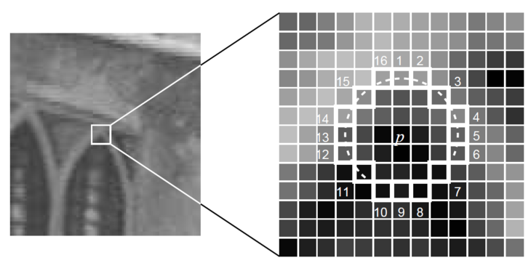
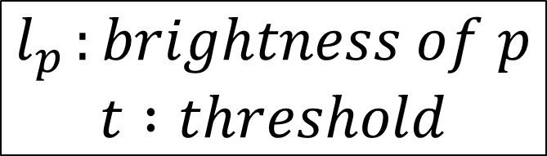
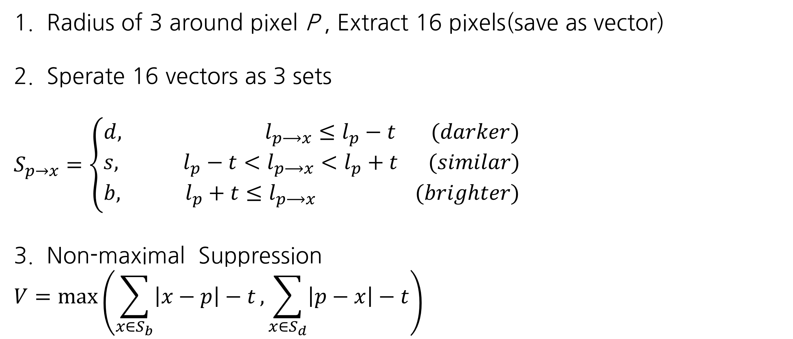
ORB-SLAM
ORB - Oriented FAST & Rotated BRIEF
FAST : Features from Accelerated Segment Test
-> Corner Finding Feature point in the Video
1. Radius of 3 around pixel P , Extract 16 pixels(save as vector)
2. Sperate 16 vectors as 3 sets
$$S_{p→x}=\left\{\begin{aligned}d, l_{p⟶x}≤l_{p}−t (darker) \\ s, l_{p}−t<l_{p⟶x}<l_{p}+t (similar) \\ b, l_{p}+t≤l_{p⟶x} (brighter)\end{aligned}\right.$$
3. Non-maximal Suppression
$$V=max⁡\left(\sum_{x∈S_{b}}{\left|x−p\right|−t},\sum_{x∈S_{d}}{\left|p−x\right|−t}\right)$$
$$l_{p }:brightness of p$$
$t :threshold$
Notes:
FAST(Features from Accelerated Segment Test) 알고리즘은 영상에서 코너 특징 점을 빠르게 검출하는 알고리즘이다.
특정 후보 코너 점 p를 중심으로 반지름 3의 원에 해당하는 16개의 픽셀 값으로 16차원의 벡터를 구성한다.
각 벡터의 원소는 아래 수식과 같이 p의 밝기보다 밝거나, 비슷하거나, 어두운 세 하위 집합으로 나눌 수 있다.
하나의 코너 후보 점 p와 인접한 후보 코너 점들에 대해 V를 계산하여 값이 큰 후보 코너 점을 코너 특징 점으로 선택하는 방법이다. 이러한 방법을 통해 코너 주위로 다중 코너 특징점이 검출되는 약점을 보완했다.

Slide 4
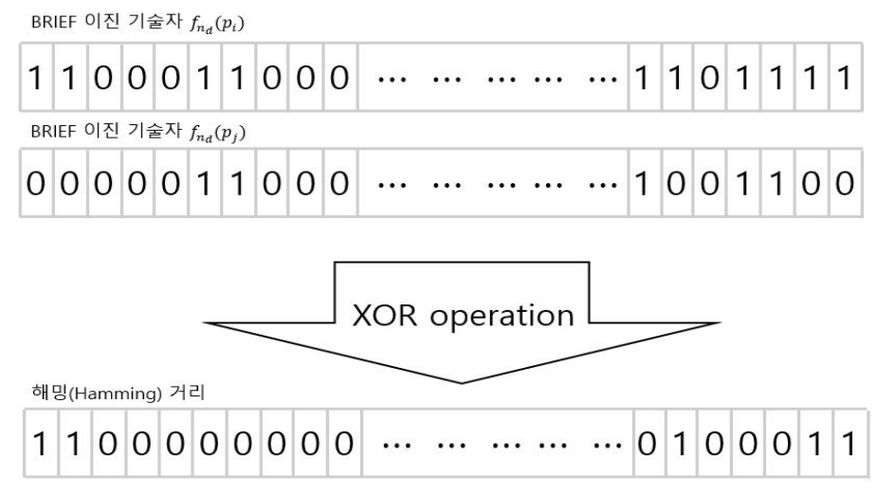
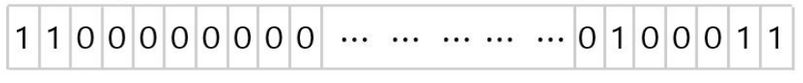


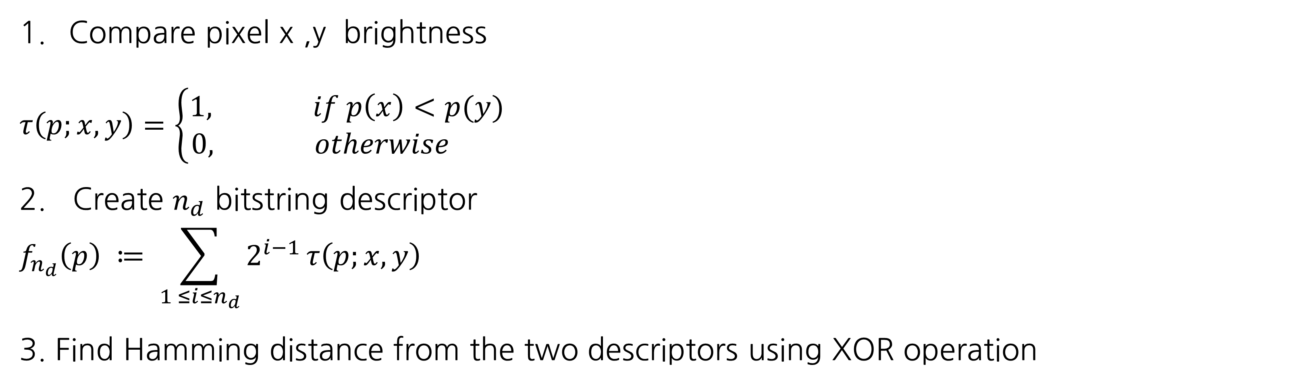
ORB-SLAM
ORB - Oriented FAST & Rotated BRIEF
BRIEF : Binary Robust Independent Elementary Features
-> Create a descriptor using feature points and surrounding pixels
Compare pixel x ,y brightness
$$τ\left(p;x,y\right)=\left\{\begin{aligned}1, if p\left(x\right)<p(y) \\ &0, otherwise \end{aligned}\right.$$
2. Create $n_{d}$ bitstring descriptor
$$f_{n_{d}}\left(p\right) ≔ \sum_{1 ≤i≤n_{d}}{2^{i−1}}τ\left(p;x,y\right)$$
3. Find Hamming distance from the two descriptors using XOR operation
$f_{n_{d}}\left(p_{i}\right) :$
XOR
Hamming distance
$f_{n_{d}}\left(p_{j}\right) :$

Slide 5
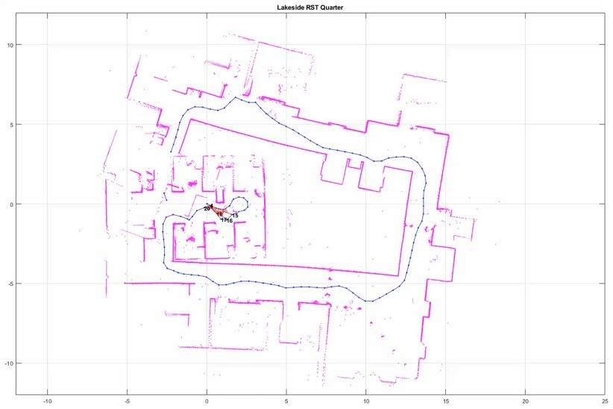
ORB-SLAM
SLAM - Simultaneous Localizing & Mapping
Localizing : Estimation of Camera Pose
Mapping : 3D Map Reconstruction
Visual SLAM - Simultaneous Localizing & Mapping with Camera Sensor
Monocular Camera
Stereo Camera
RGB-D Camera

Slide 6
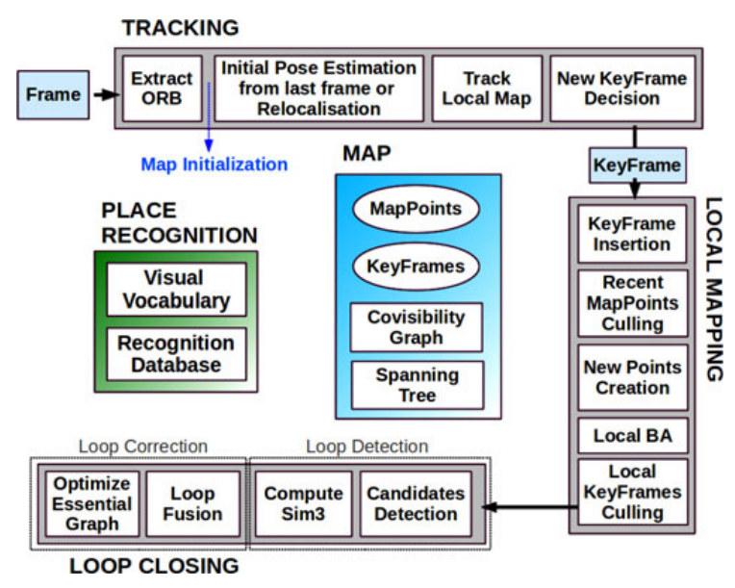
ORB-SLAM

Slide 7
ORB-SLAM
Tracking
Localizing the camera by every frame
Deciding when to insert a new keyframe
Local Mapping
Processing new keyframes
Performing Local BA to achieve an optimal reconstruction
Loop Closing
Searching for loops with every new keyframe
-> The three threads that run in parallel : Tracking, Local Mapping and Loop Closing

Slide 8
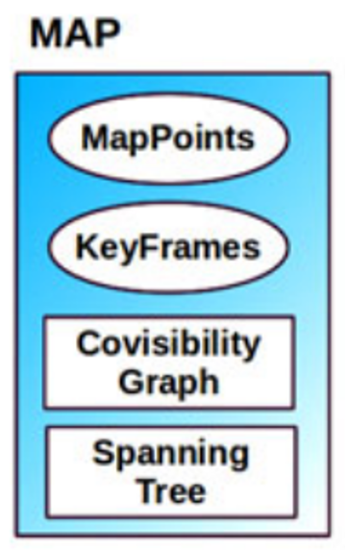
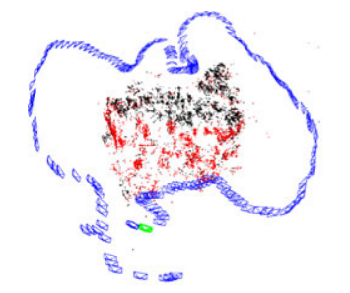
MAP
MapPoints : 3d feature points in map
3d position
ORB descriptor
Viewing distance
KeyFrames : frame with many meaningful feature
Camera Pose
Camera Intrinsics
ORB feature in the frame
Covisibility Graph
Spanning Tree
KeyFrames
Current Camera
Current Local Map points
Map points
Notes:
Blue : keyframe
Green : Current Camera
Red, Dark : Map point
Red : Current map point

Slide 9
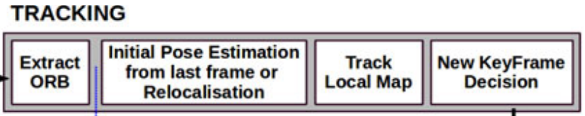
TRACKING
A. Extract ORB
Detect corners and compute descriptor with FAST & BRIEF
B. Initial Pose Estimation from last frame
Tracking was successful for last frame => Use a constant velocity motion model to predict camera pose and perform a guided search of the map points observed in the last frame
=> Pose estimation
C. Initial Pose estimation via global relocalization
Tracking is lost => Convert the frame into bag of words and query the recognition database for keyframe candidates for global relocalization
Perform alternatively RANSAC iterations for each keyframe and try to find a camera pose using the PnP algorithm => Pose estimation
Notes:
Tracking 실패 시 해당 frame을 bag of words 방식을 통해 데이터를 저장하고 RANSAC과 PnP algortihm을 활용해 카메라의 최적은 Pose estimation을 추정함

Slide 10
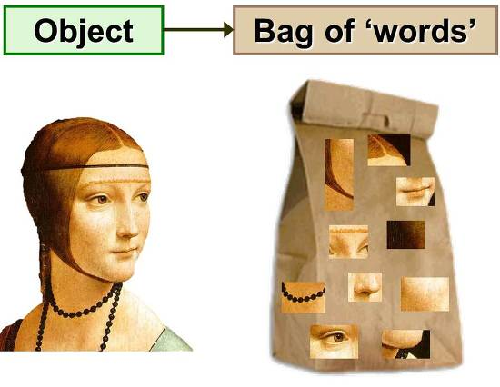
Bag of Words
=> Recognizing and Learning Object Categories
Feature Extraction
- Extract feature from image
Clustering
- Using features and clustering and find the codeword based on cluster center(Representative feature)
<= Codeword in the Bag

Slide 11
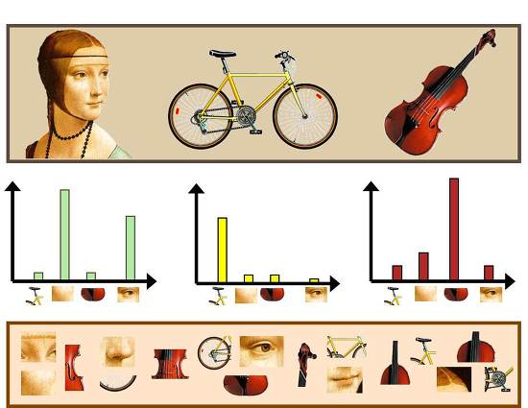
Bag of Words
=> Recognizing and Learning Object Categories
3. Codebook Generation
- Create Code book with the codewords form all objects
4. Image Representation
- Make a histogram of given new images for codewords
5. Learning and Recognition
- Recognize each material base on probability

Slide 12
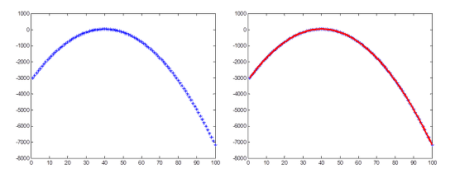
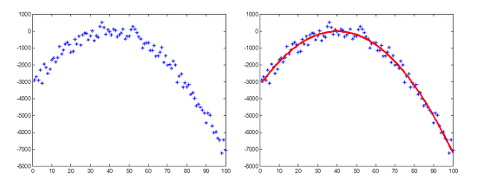
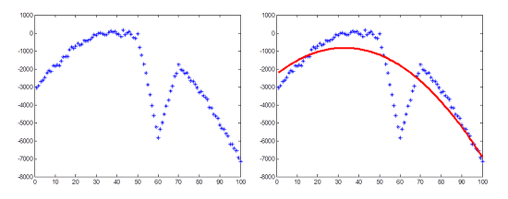
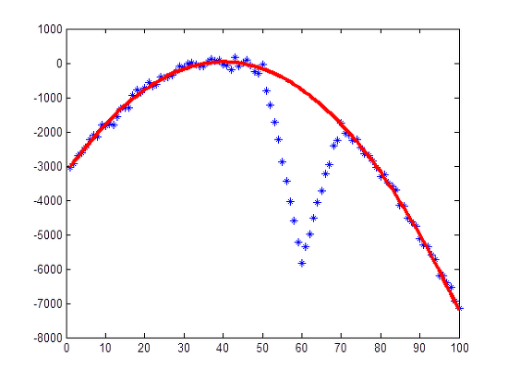
(RANdom SAmple consensus)
RANSAC
<Ideal case>
<Normal case>
=> In Normal Case there are noise in the dataset
<Extreme Case>
<Least Square Method>
<RANSAC>
=> Using RANSAC in Extreme Case, we can get better consensus
Notes:
Consensus : 추정치

Slide 13
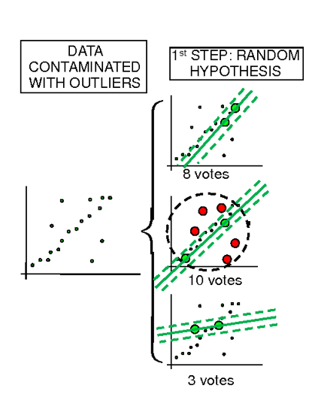
(RANdom SAmple consensus)
RANSAC
Hypothesis
Choose Nth sample data from dataset
Guessing the model parameter by the sample data
Verification
Count the data that match with dataset from the model parameter
If the counted data is bigger than before, create new model parameter
Iterative
<Data Set>
<Model parameter1>
<Model parameter2>
<Model parameter3>
Notes:
Consensus : 추정치

Slide 14
PnP Algorithm
(Perspective n Point)
=> Method for estimating 3D to 2D motion
Input
Correspondences of 2D coordinates & 3D world location
Intrinsic parameter of the camera
- Focal length, Optical center, Radial distortion
Output
Camera pose
- Rotation vector, Translation vector
Notes:
Consensus : 추정치

Slide 15
TRACKING
D. Track Local Map
Project the map into the frame and search more map point correspondences
To bound the complexity in large maps, we only project a local map
Local map contains the set of adjacent keyframes which share map point in the covisibility graph
After some stage => The camera pose is finally optimized with all the map points found in the frame
Notes:
Track local Map이 하고자 하는 것은 프레임 속에 찾은 map points를 바탕으로 카메라 위치를 최적화하기
Frame에 map을 project 하면서 covisibility graph를 생성함

Slide 16
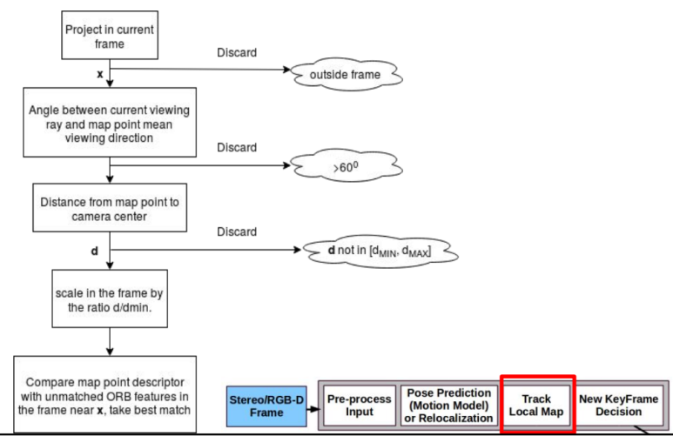
After some stage
Each map point seen in adjacent keyframes is searched in the current frame as follows …

Slide 17
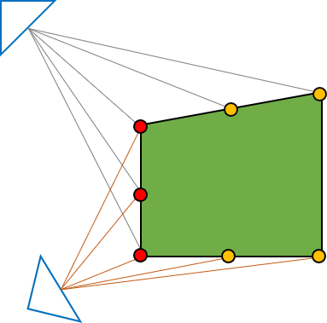
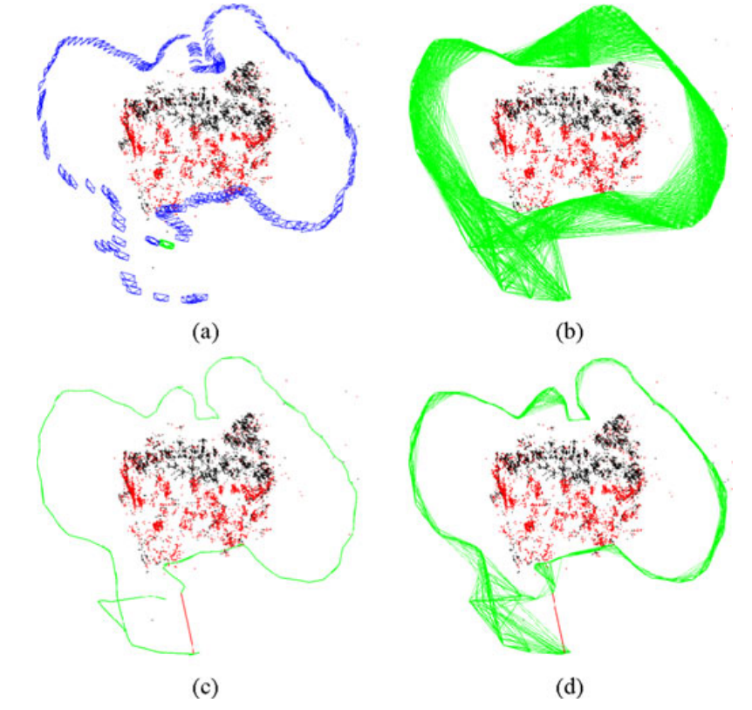
Covisibility Graph
expressing the number of projected overlapping parts of two or more cameras
<Camera_2>
<Camera_1>
Node : Keyframe
Edge : Share observations of map points
Min share map points : 15

Slide 18
Covisibility Graph
Each node is a keyframe, and an edge between two keyframes exists if they share observations of the same map points (at least 15), being the weight θ of the edge the number of common map points
Node : Keyframe
Edge : Share observations of map points
Min share map points : 15
Notes:
최소 15 map points 가 있어서 Keyframe 간격 설정

Slide 19
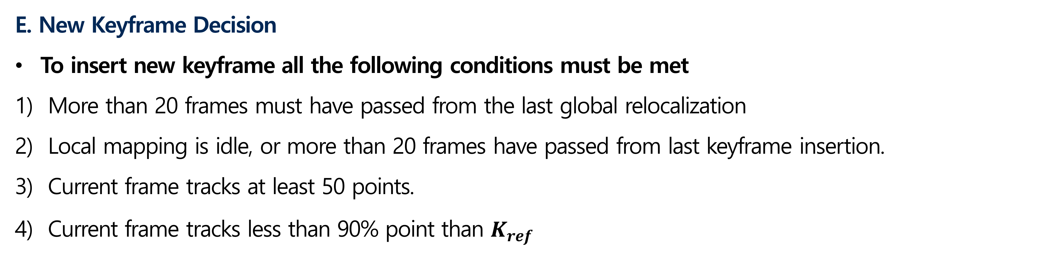
TRACKING
E. New Keyframe Decision
To insert new keyframe all the following conditions must be met
More than 20 frames must have passed from the last global relocalization
Local mapping is idle, or more than 20 frames have passed from last keyframe insertion.
Current frame tracks at least 50 points.
Current frame tracks less than 90% point than $K_{ref}$
Notes:
1. 마지막 global relocalization후, 최소 20frame 이후의 frame (너무 유사하면 의미가 없음)
2. Local mapping 수행이 적합하거나 마지막 keyframe 추가 후, 20 freame 이후의 frame
3. 현재 frame이 최소 50개 이상의 특징점을 track
4. 현재 frame이 reference keyframe의 90% 이하의 특징점을 track

Slide 20
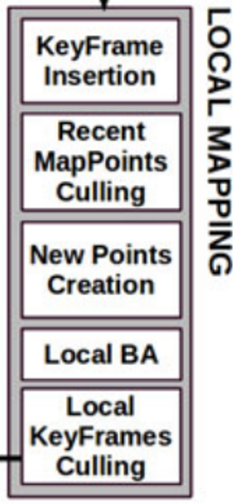
LOCAL MAPPING
Key Frame Insertion
Compute bags of words which will help for triangulation new points
Update Covisibility graph adding a new node and updating the edges
B. Recent Map Points Culling
=> Reduce bad points (Low visibility , Not track table)
Map points pass a restrictive test during the first three keyframes after creation
The tracking must find the point in more than the 25% of the frames in which it is predicted to be visible
If more than one keyframe has passed from map point creation, it must be observed from at least three keyframes.
Notes:
KeyFrame Insertion
- tracking thread에서 새로운 key frame이 생성되면 이 key frame의 bag of words를 계산한다.
- 이를 바탕으로 새로운 key frame과 원본 영상 프레임의 map point를 비교한다.- 그 후, covisibility graph를 update한다
Recent MapPoints Culling
- Traking 과정 후에 생긴 Map point들과 새로 삽입된 key frame을 비교하여 bad point를 제거한다.
- low visibility, not trackable 점

Slide 21
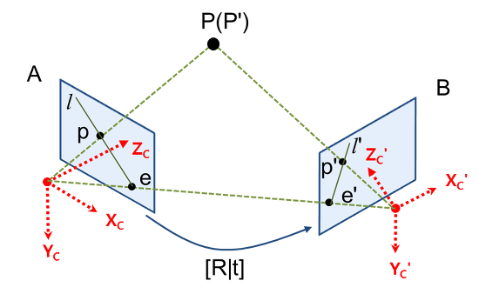
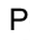

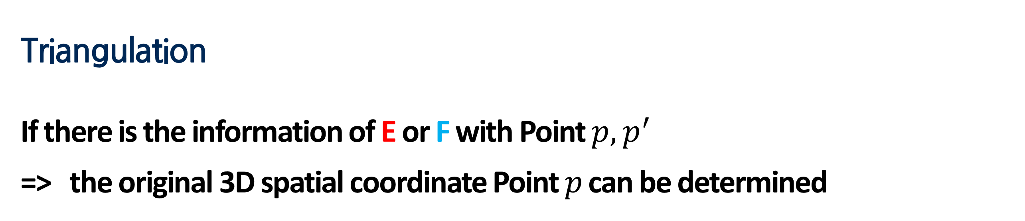
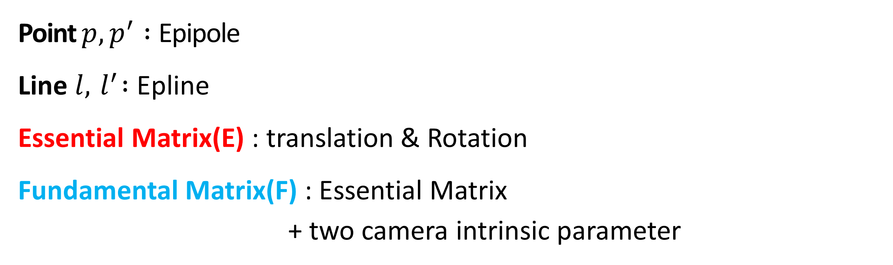
Triangulation
<Epipolar Geometry>
Point ${p,p}^{′} :$Epipole
Line $l,{ l}^{′} :$ Epline
Essential Matrix(E) : translation & Rotation
Fundamental Matrix(F) : Essential Matrix
+ two camera intrinsic parameter
p’
p’
Triangulation
If there is the information of E or F with Point ${p,p}^{′}$
=> the original 3D spatial coordinate Point $p$can be determined
Notes:
Epipolar geometry는 동일한 사물 또는 장면에 대한 영상을 서로 다른 두 지점에서 획득했을 때, 영상 A와 영상 B의 매칭쌍들 사이의 기하학적 관계를 다루는 것입니다

Slide 22
LOCAL MAPPING
C. New Points Creation
New map points are created by triangulating ORB from connected keyframes in
the covisibility graph
D. Local BA
=> Optimize the number of map points
The local BA optimizes the currently processed keyframe, all the keyframes
connected to it in the covisibility graph, and all the map points seen by those keyframes
Notes:
C. New map point를 triangulation을 통해 구하여 새롭게 Mapping 진행
D. 너무 많은 Map points들이 생기지 않도록 최적화 진행
그중 Local BA 활용

Slide 23
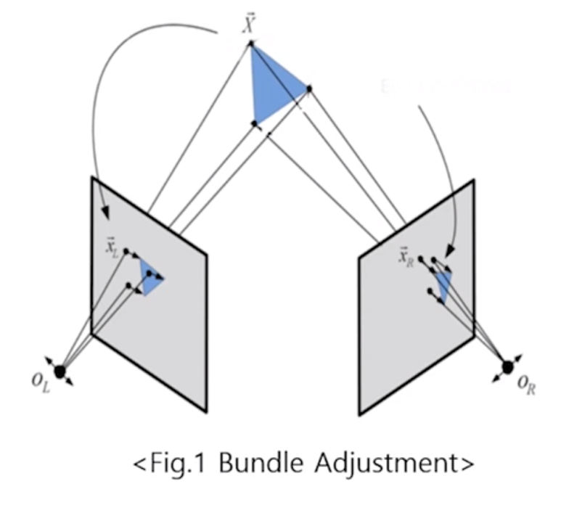
BA
(Bundle Adjustment)
=> Optimize 3D points location and Camera pose to minimize reprojection error
<Flow Chart of Optimization>
Input Image
Extract feature point
Estimate Camera pose
Triangulation
Bundle Adjustment
Optimize 3D points & Camera pose
Notes:
Budle : 보따리

Slide 24
LOCAL MAPPING
E. Local KeyFrames Culling
=> limit the keyframes
Discard all the keyframes whose 90% of the map points have been seen in at
least other three keyframes in the same or final scale
Notes:
Local KeyFrames Culling
- > key frame의 개수를 제한한다.
모든 key frame들은 적어도 3개 이상의 다른 key frame의 map point들과 90%의 covisibility 연결이 되어 있어야 한다.
key frame이 너무 많으면 relocalization과 bundle adjustment의 효과가 적어진다

Slide 25
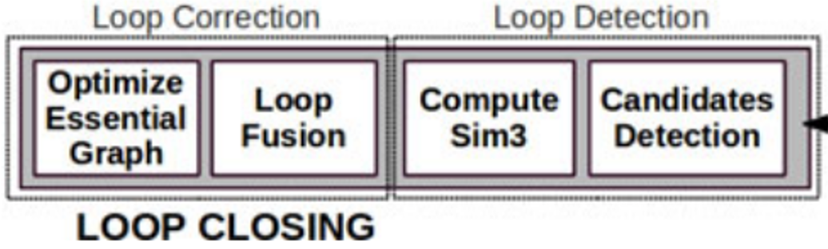
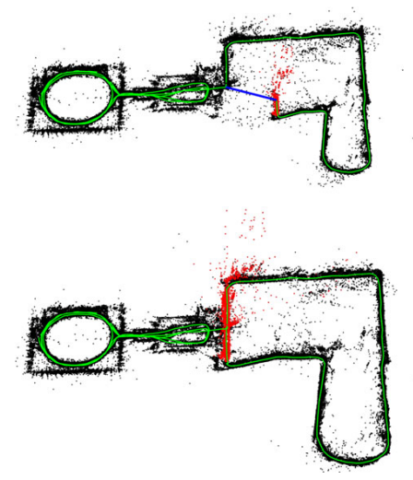
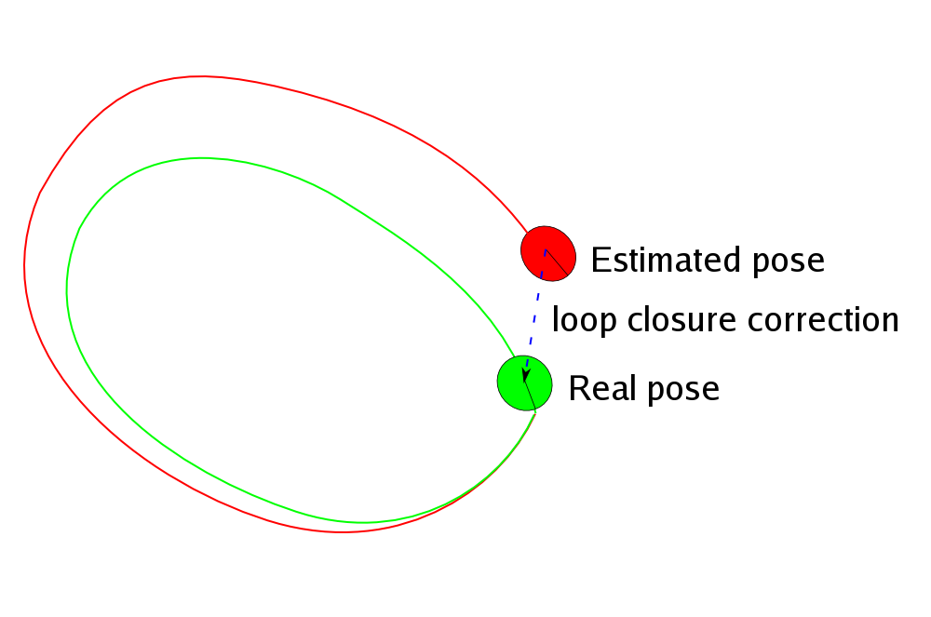
LOOP Closing
Loop Closure
Trajectory
Local Map for the tracking at that moment
Notes:
Trajectory : 궤적
Loop Closure : 루프 폐쇠

Slide 26
LOOP Closing
Loop Candidates detection
Compute the similarity between the bag of words vector of keyframe and all its neighbors in the convisibility graph
B. Compute Similarity transformation
To close a loop, compute a similarity transformation from the current keyframe to the loop keyframe that error accumulated
Compute correspondences between ORB between current keyframe and loop candidate keyframe and perform RANSAC iteration with each candidate
If the candidate is supported enough inliners, the loop is accepted
Notes:
기존과 그래프와 현재 frame에서 얻은 정보가 얼마나 비슷한지 the bag of words를 통해 만든 현재 keyframe로 convisibilty graph 를 통해 확인함
기존과 현재에 어느정도 transform 되어서 error가 축적되었는지 확인후 RANSAC 방식을 통해서 기존과 어느정도 일치하다고 추가로 판단

Slide 27
LOOP Closing
C. Loop Fusion
Fuse duplicated map points and insert new edges in the covisibility graph that will attach the loop closure
All keyframes involved in the fusion will update their edges
D. Essential Graph Optimization
To effectively close the loop, Perform a pose graph optimization over the essential graph
Notes:
3) Loop Closure를 결합시키는 작업을 하기 위해 Covisibility graph의 edge 정보 추가
4) 최적화를 통해서 loop를 완성시켜 그래프화함

Slide 28
ORB SLAM Limitation
Work in Monocular Camera
Able to simulated on indoor and outdoor
ORB SLAM2
Work in Monocular Camera, Stereo Camera and RGB-D Camera
Able to simulated on more complex environment
-drones flying in industrial environments
-cars driving around a city
ORB SLAM3
Work in Monocular Camera, Stereo Camera and RGB-D Camera
Able to simulated on more complex environment
More accurate 2, 5times more
Able to handle mapping by restarting and merged to pervious situation in the poor visual environment

Slide 29
THANK YOU

